Slide 1
FuelMart & Subway Safety Committee Meeting
Wednesday, Feb. 20, 2019
2:00 PM
Corporate Office Conference Room and GoTo Meeting Web Conference

Slide 2
1. Safety Committee Purpose and goal 2. Ohio and Non-Ohio Injury sleeve packets 3. Work related injury discussion 4. Incident report form 5. document reminder – www.fuelmart.com/docs.php No open items No items to close out
Jan. 2019 Review of Previous Meeting minutes:

Slide 3
Safety Topic: Incident Photos

Slide 4
Company Policy: Incident Reporting
When reporting any property damage, vehicle accidents, spills, or injuries, the following procedures will need followed in order to avoid any disqualifications:
Notification: ALWAYS call Phillip Le Claire-Safety Director
Incident Report Form
Photos (see following slides for examples)
Notes:
In discussing disqualification items, it is important to bring up company policies regarding incident reporting, as the company can fight on the driver’s behalf in certain situations when policies are followed.
For example:
A driver was going through a neighborhood and hit a low hanging power line, bringing it down. He kept driving, thinking that the line was below the regulatory height, so it wasn’t his fault that it came down. A resident called police who in turn called Ports looking for the driver. This could be considered leaving the scene of an accident, because the driver didn’t report the downed line to authorities or Ports. However, as it was merely a telephone line, the situation was used as a “teaching moment.” Had the driver notified Ports using the following procedures, when the phone call from the police came, it could have easily been sorted out.
General Procedures:
Notification:
ALWAYS call Phillip Le Claire-Safety Director! On call 24/7.
If you can’t get a hold of Phillip, call Dan Geraghty, Director of Transportation. If you can’t get a hold of either, call 24 hour Dispatch.
Phillip has a form he has to fill out, so he will be asking many questions. May take more than one phone call.
Always make sure to call Phillip one last time before leaving to ensure everything is complete and correct.
Police: Emergency or non-emergency dispatch
Beneficial because the call gets recorded whether or not the police come to the scene.
If police do come to the scene, get officer’s name, badge number, department, and police report number.
No amount of damage is too small. If there is any type of incident, even if it doesn’t result in damage or results in minimal damage, report it!
Incident Report Form:
Paperwork kept in all of the trucks’ permit books.
Always fill it out (some of it may not always apply). Write N/A if that section does not apply and move on to the next. Use the form as a guide.
Photos:
Use the truck phone with the Camera app. NEVER use CamScanner to take incident photos. CamScanner should only be used to take pictures of paperwork/documents, because it creates a PDF and does not allow for editing to the photos to adjust light levels, etc.
The following slides will discuss incident photos in greater detail before going into the specifics of the different types of incidents.

Slide 5
Incident Photos: Bigger Picture
Take a picture of the whole scene from 20 feet away if it is safe to do so.
Always start out and work your way in.
Notes:
When taking photos for the majority of incidents, always start out and work your way in.
A picture of the whole scene from farther away can provide additional details that closer photos wouldn’t be able to convey, such as weather conditions, location, skid marks, number of people, spill position, etc.

Slide 6
Incident Photos: Vehicles
If another vehicle is involved, always take pictures of it before Ports’ property.
Corners at 45º angles
Notes:
Ports’ vehicle pictures can always be taken at another time.
Get at least the 4 corners of the vehicles at 45 degree angles. This shows more of the damage (i.e., the depth of the dents, etc. (turquoise arrows)
Corners also help when taking pictures of the semi, because you can be closer to the truck and still get the whole side of the vehicle in two photos.
If time, may take additional pictures of each side straight on. (green arrows)
If necessary, close-up pictures of damage may be taken as well.

Slide 7
Incident Reporting: Accident Photos
Notes:
Photos taken at corners—no damage, but can see how you can get more of the truck while only standing 4 feet away.
Can digitally zoom if necessary

Slide 8
Incident Reporting: Accident Photos
Notes:
Picture on the left:
Can see the depth of the dent due to the sunlight reflection on the truck.
Picture on the right:
Photo taken closer, but still at an angle.
Can see depth of the scratch. With a straight on photo, would only get a line.
$10,000 worth of damage for sideswiping a dumpster.

Slide 9
Incidents and Injuries

Slide 10
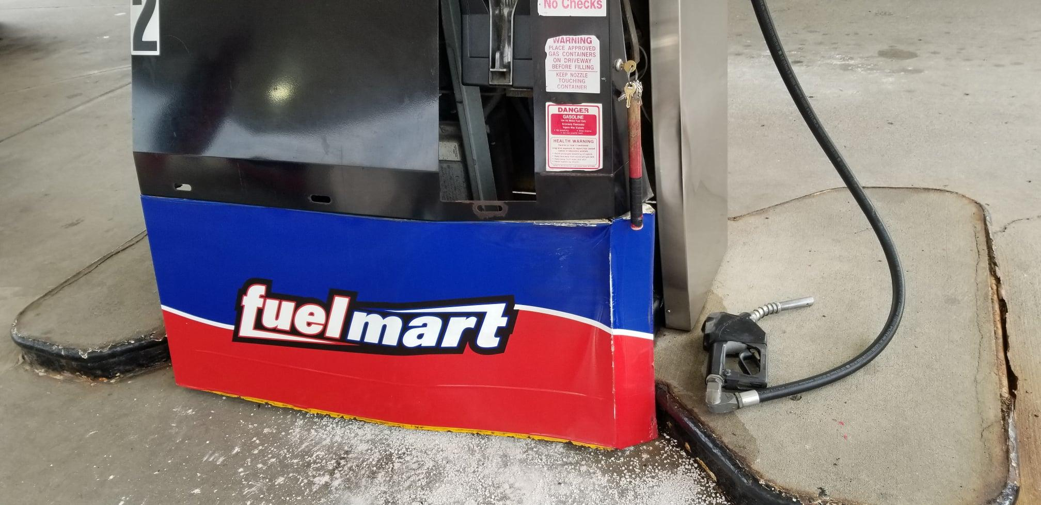
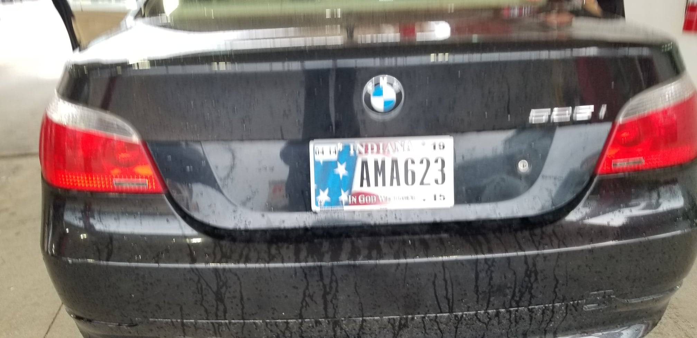
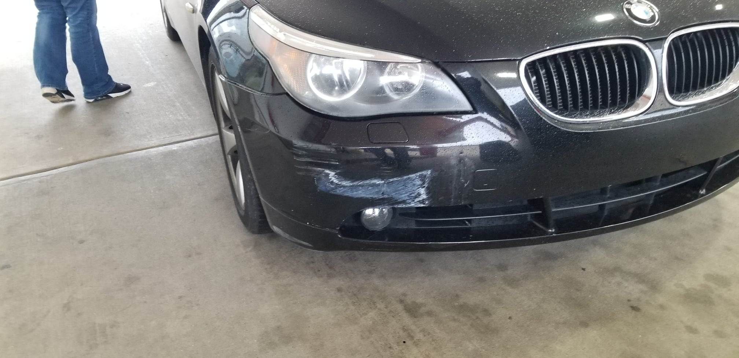
FM 648 Customer
struck pump:
On 01/07/2019 at approx. 10:30 am a customer pulled up on the wrong side to get gas, she went around pumps and was still on the wrong side. She pulled forward then backed up to cut the wheel but was too close and hit the pump.

Slide 11
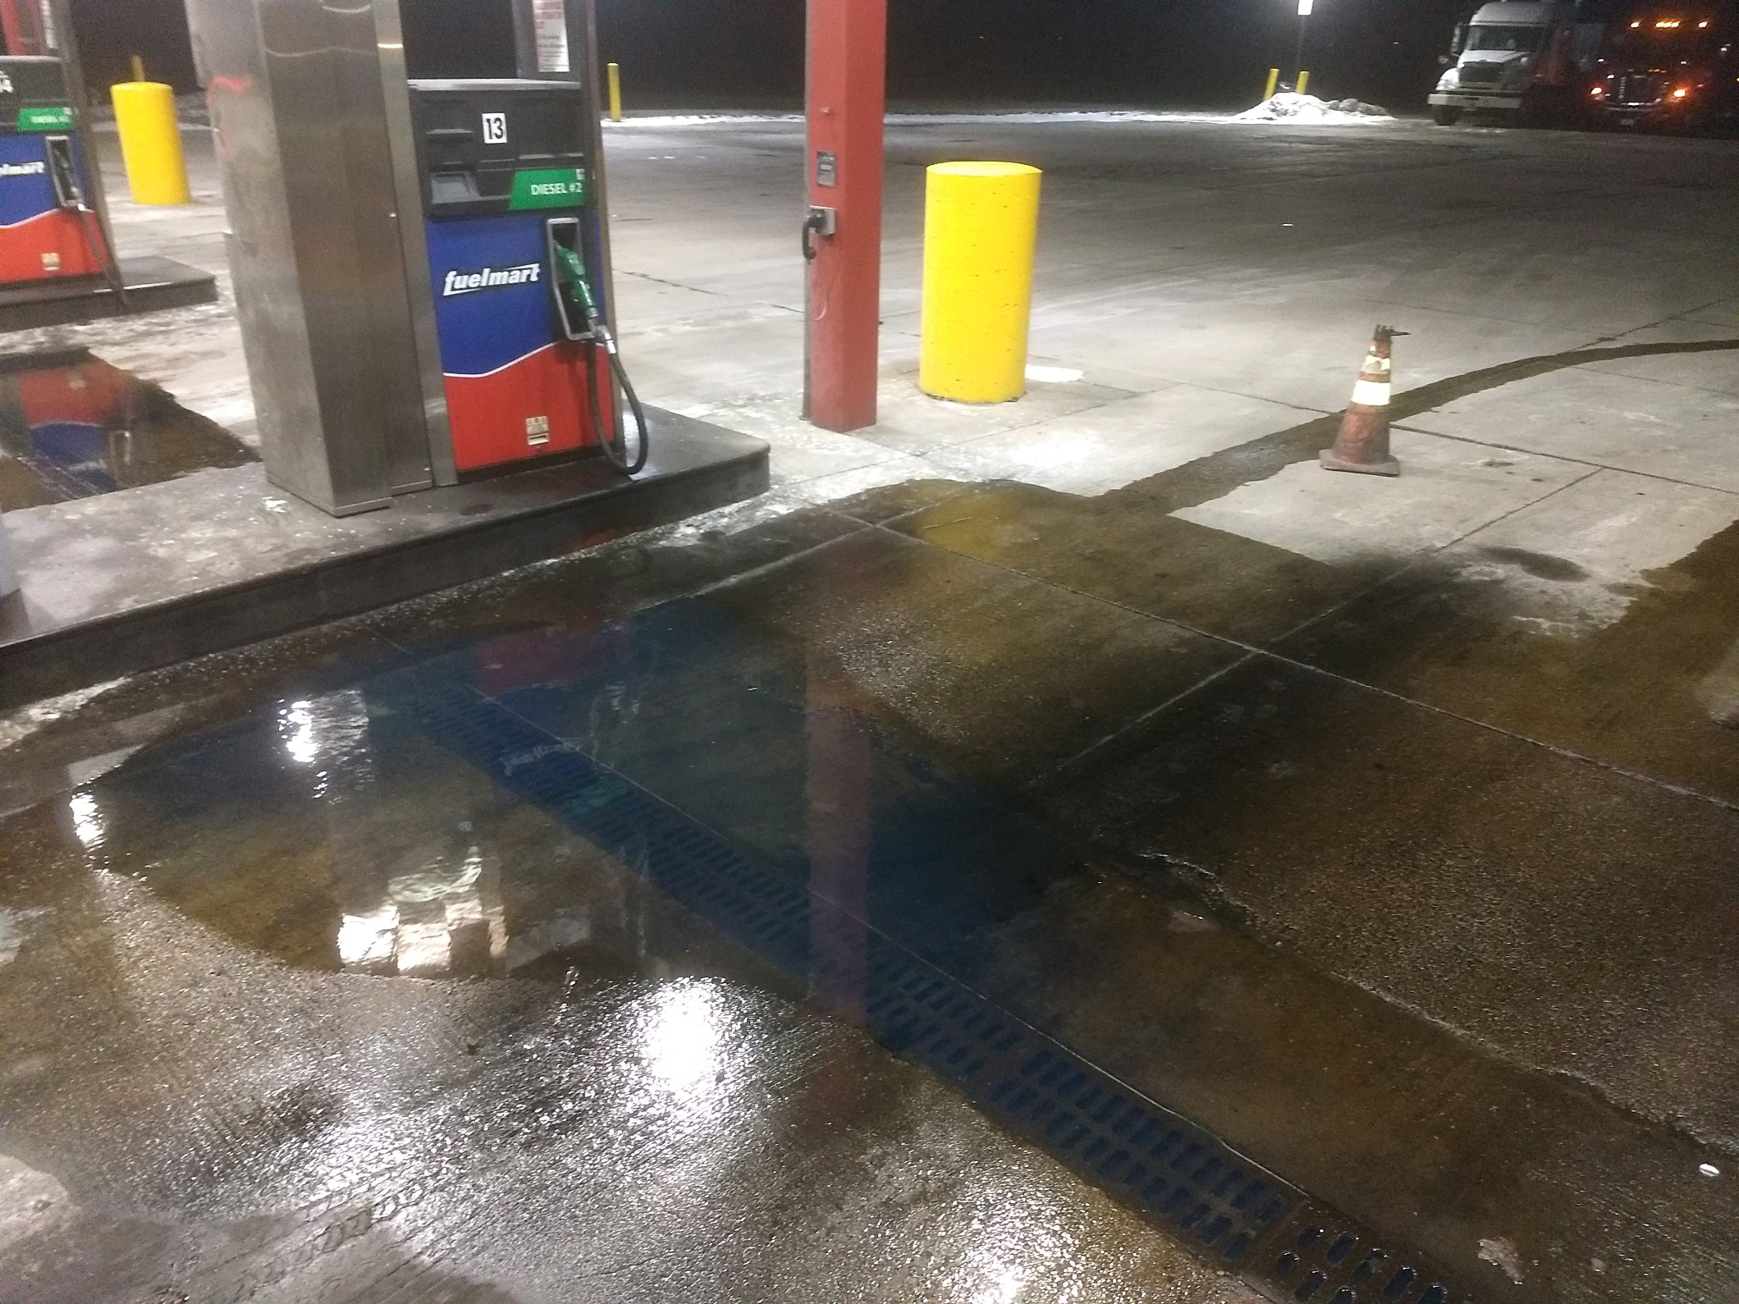
FM 787 Customer Diesel Spill:
On 01/27/2019 at approx. 6:10 pm Central a customer informed a FM employee that he had a minor spill at the diesel pump. An unknown amount of product was spilled. The Diesel island drain was clogged. FM employees took no action. Customer took a shower and left without providing any information.

Slide 12
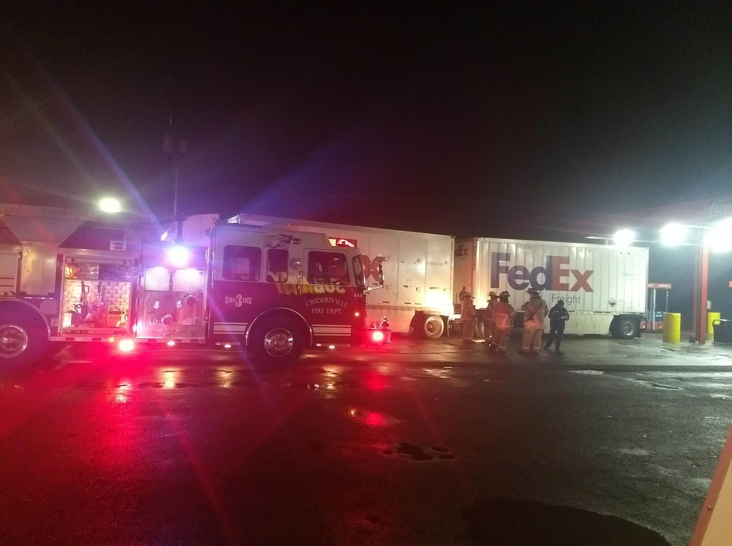
Fm 782 FedEx Freight
Trailer Leak:
On 02/05/19 at approx. 3:15 am a FedEx driver informed a FM employee he had acid leaking out of his semi-trailer and a small amount was on the asphalt. Local police dept., fire dept., fire marshal, County EMA Director, and Ohio EPA responded. FM employee notified manager, Safety Director and obtained BOL.

Slide 13
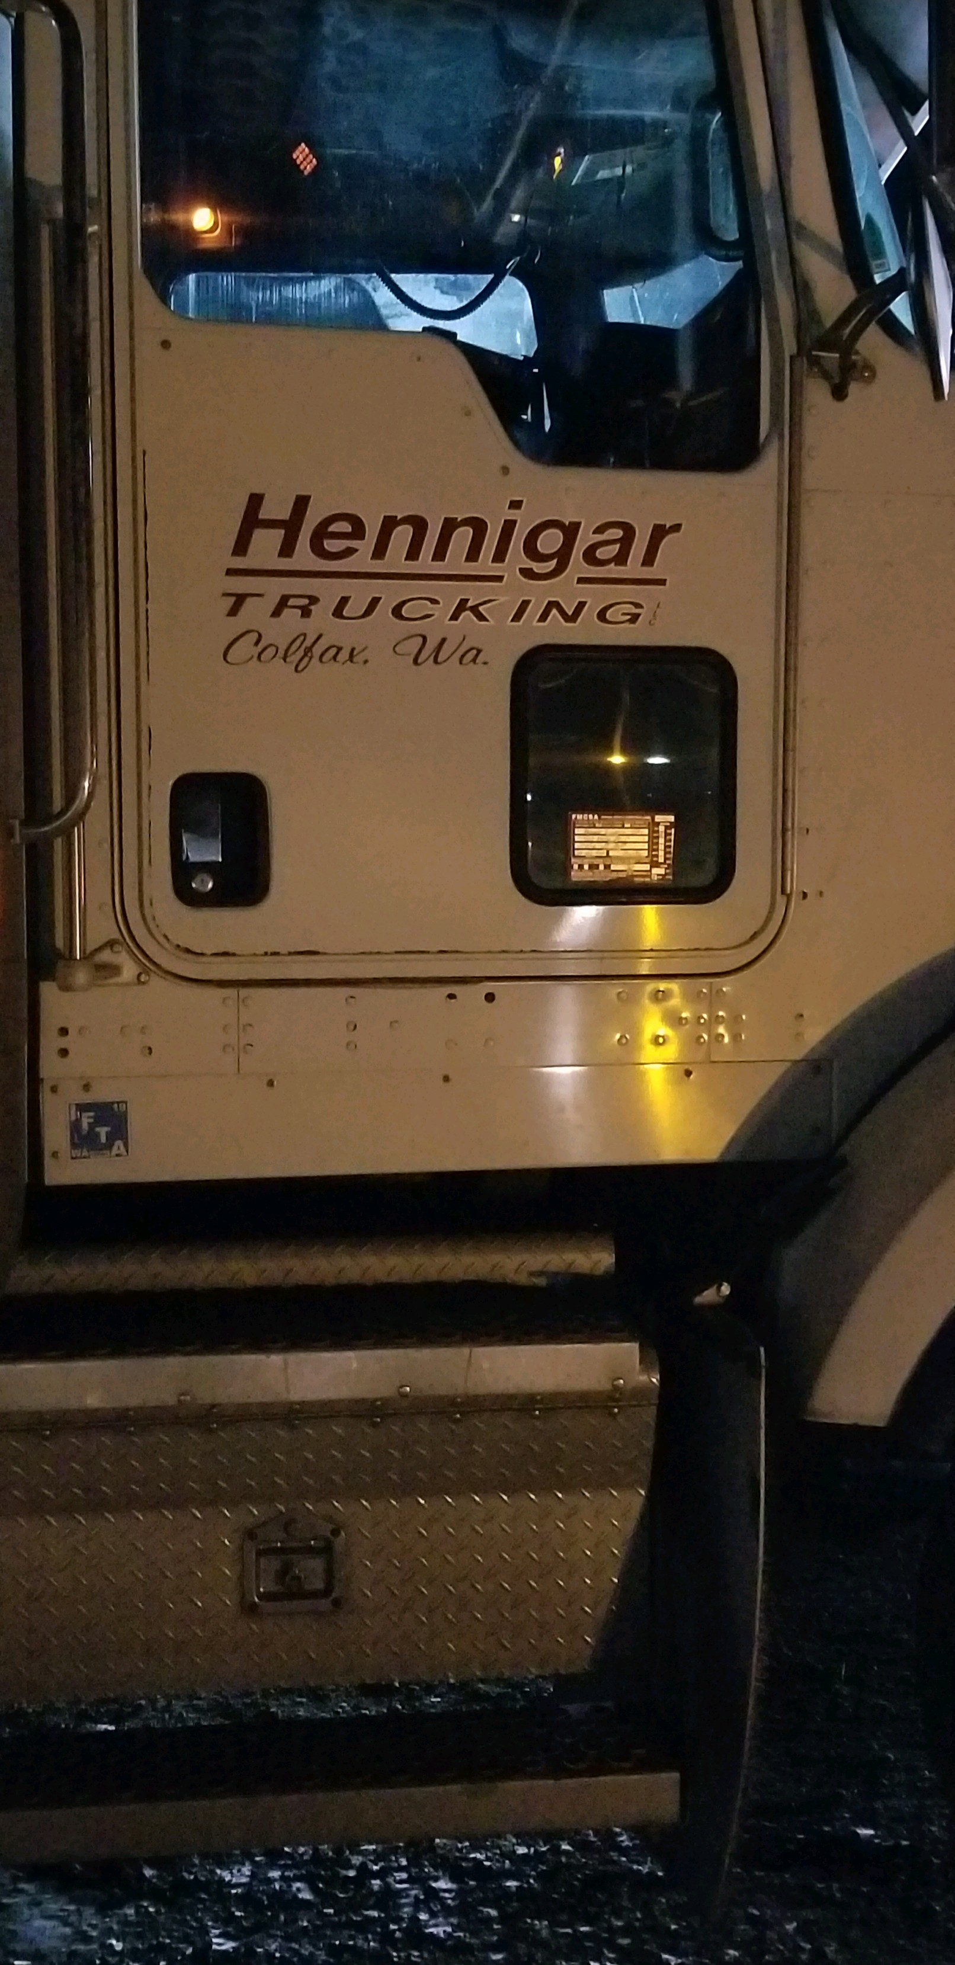
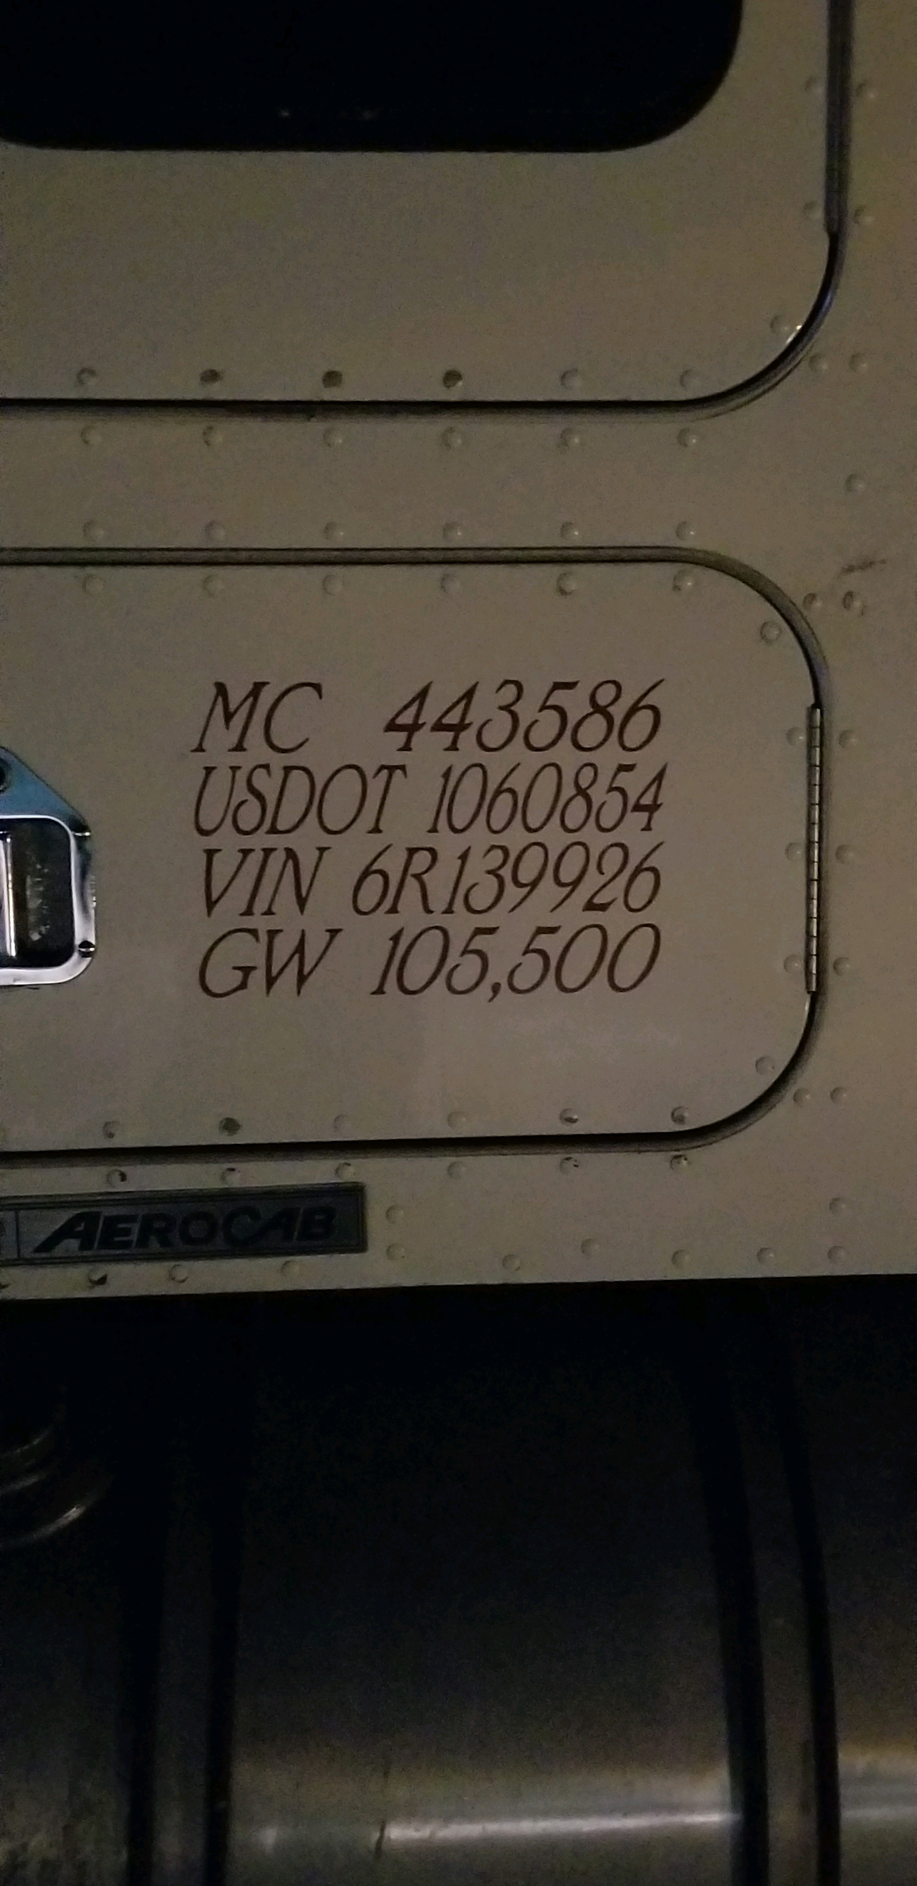
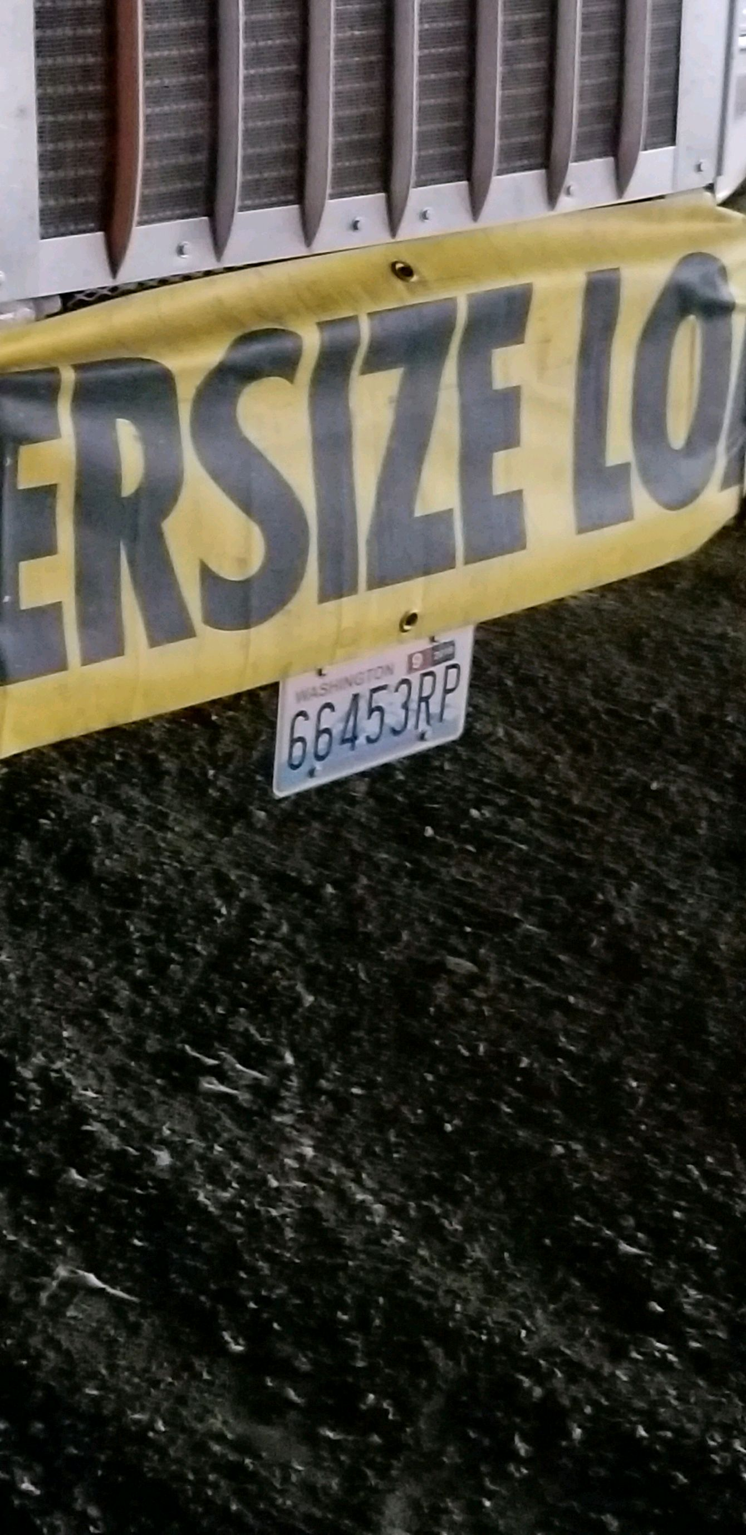
FM 645 Customer struck light pole:
On 01/31/2019 at 7:00 pm Central a semi-trailer backed into a wooden pole parking lot light snapping it in half. Pole landed in the grass area. No damage to other vehicles, pedestrians, or structures. No loss of electric. Took photos of driver license and insurance card.

Slide 14
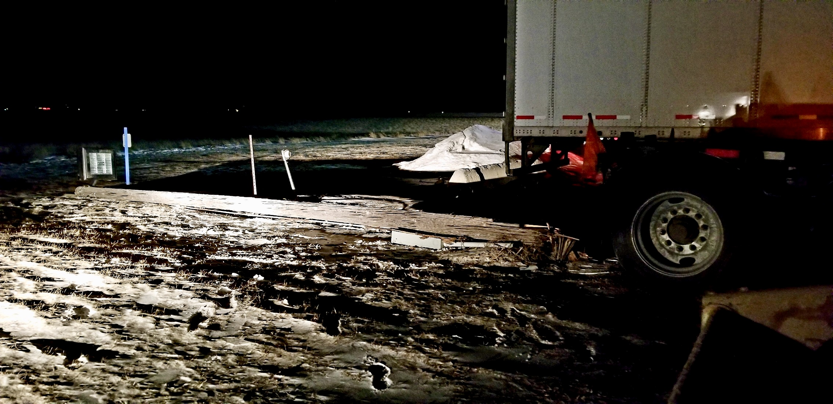
FM 645 Customer struck light pole:

Slide 15
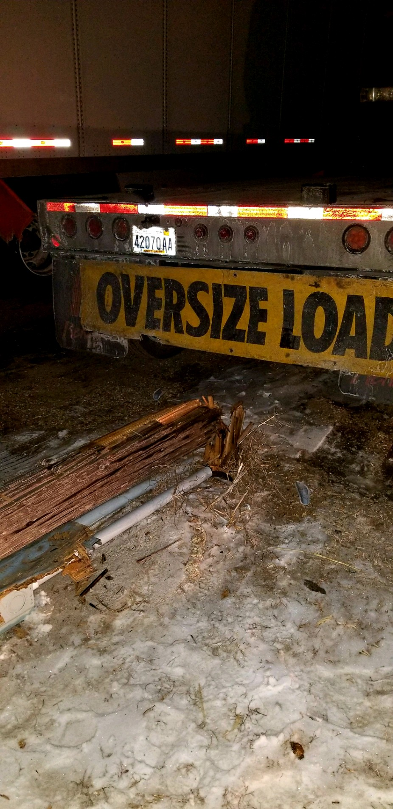
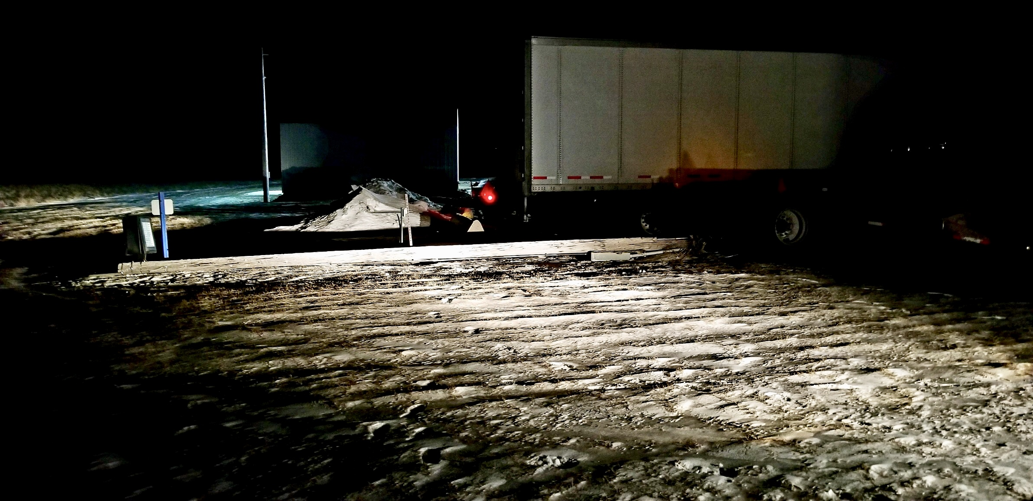
FM 645 Customer struck light pole:

Slide 16
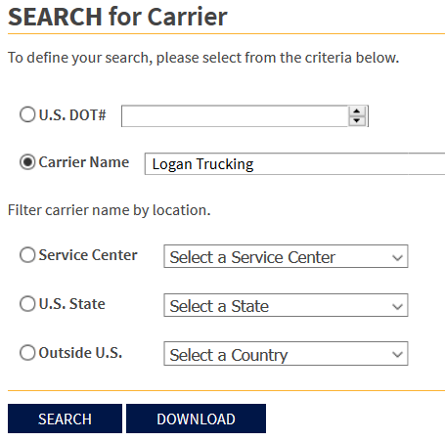

Slide 17
Employee Injuries:
01/04/19 – Subway employee sustained a burn to the arm from a hot pan
01/04/19 – Subway employee sustained a laceration to the finger from a tomato slicer in the sink.
01/14/19 – FM employee tripped in the cooler and sustained a fracture.
01/16/19 - cutting board fell and struck employee causing a bruise.
01/29/19 – Subway employee sustained a burn to the arm from taking bread pan out of oven.

Slide 18
Date Range: Jan. 01, 2019 – Feb. 19, 2019 Company Total Incidents: 37 FuelMart & Subway Total Incidents: 18 FuelMart Customer Spills: 2 (1 at fuel pumps) FuelMart & Subway Customer injuries reported: 4 FuelMart Property Damage and/or Vehicle Incidents: 4 FuelMart & Subway employee injuries Reported: 5 Other Incidents: 3

Slide 19
Open Floor Safety Questions / Concerns

